Slide 1
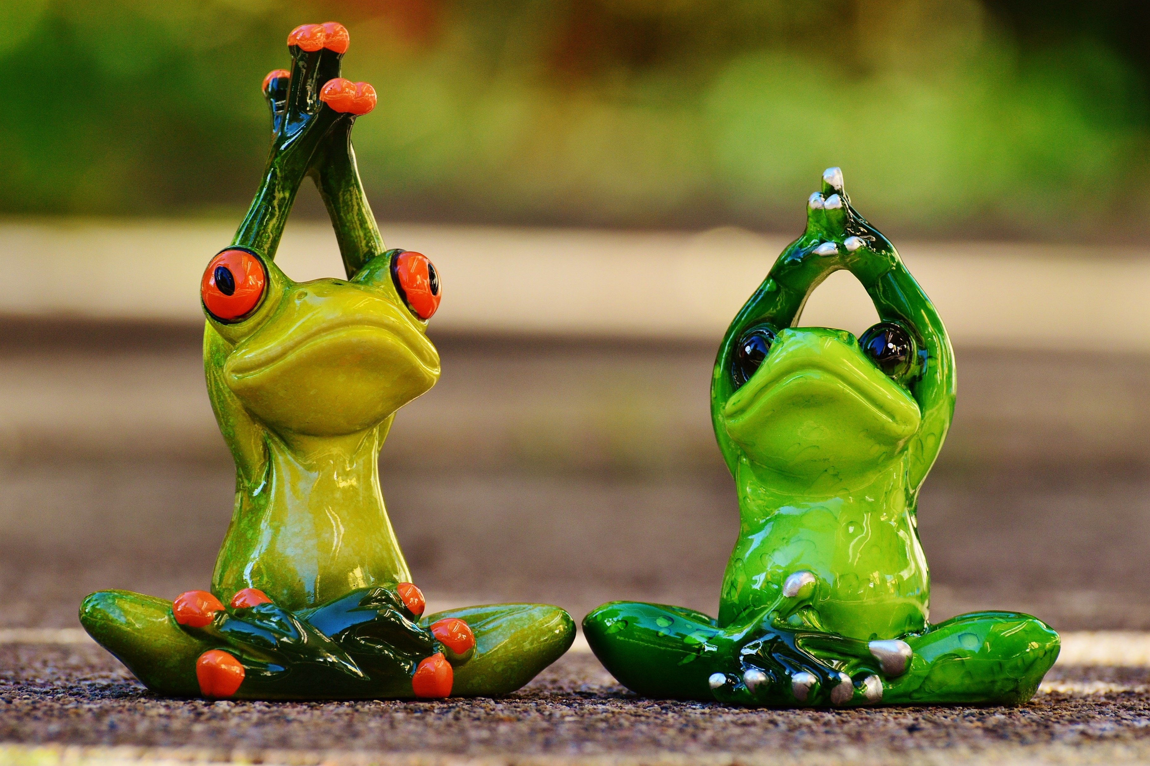
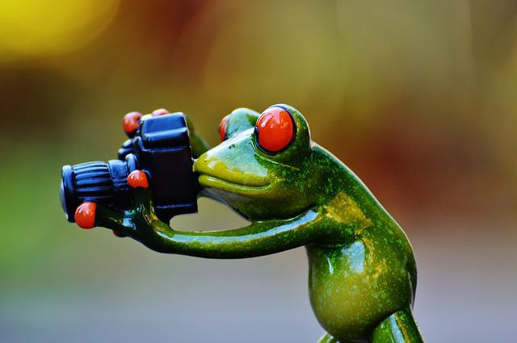
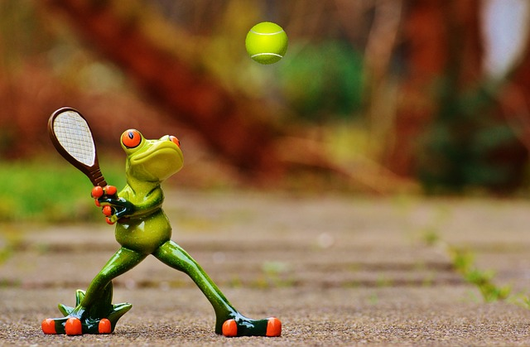

Auto Image captioning
Group 3
Sujatha
Monica
Yoga for ….
Trick Photography…
Suhail
Chaitanya
Tennis at …
Tennis at …
Make money when…
Tennis at …

Slide 2
Agenda
Summary of the Tech paper
Problem statement
Papers Reference
Architecture
CNN + LSTM
Solution - Model
Pipeline
Performance
Key Differentiators

Slide 3
Understanding the problem
Problem Statement
Preliminary Solutions
Template based Text Generation
Object detection and phrase building
Image and text in same vector space and ranking
Automated Image Captioning using AIML
Key requirements
Identify Object
Derive Object relations
Activities of the objects
Understand the Context
Auto Describe the image
Rigid and Hand designed
Fail to generate new combination of trained objects

Slide 4
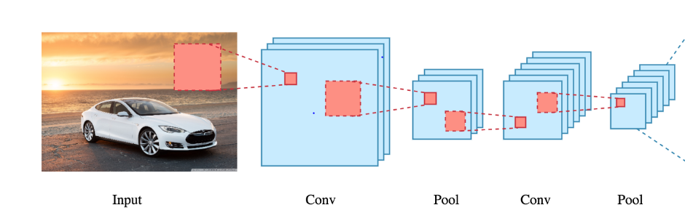
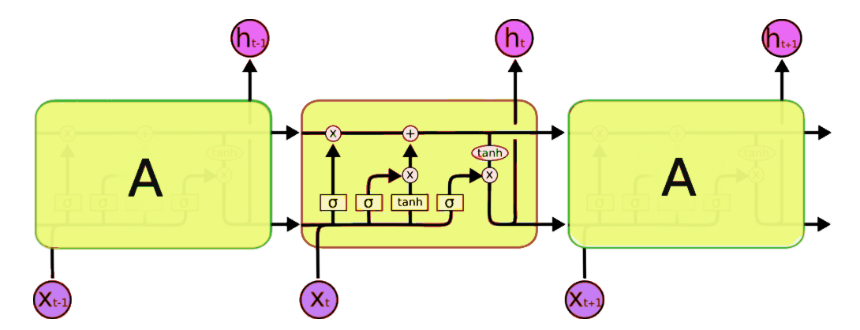
Architecture – Neural Image Caption Generator
Word
Word
Word
Caption
Features
GoogelNet CNN(Encoder)
LSTM(Decoder)
NIC is based end-to-end on a neural network consisting of a vision CNN followed by a language generating RNN
Inspiration
Text Transitions of RNN
RNN Encoders converting Text to Rich Vector representation
RNN Decoders generating Target Sentence
Summary
CNN as Encoder for providing rich Vector representation of image (last hidden layer from a pretrained classifier)
RNN Decoders generating Target Sentence

Slide 5
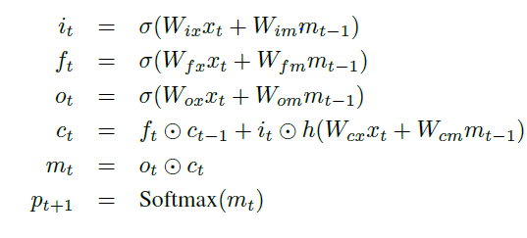
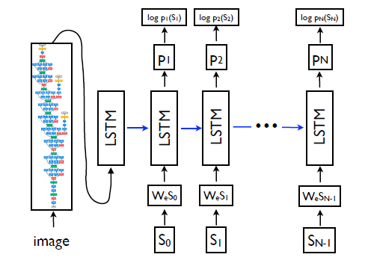
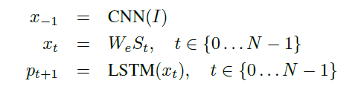

Model - Neural Image Caption Generator
Input gate
LSTM Gates
Forget gate
Output gate
Word prediction
Context
Probability
Image Vector from CNN
End to End
St - One hot encoding
Loss function
Data Sets
Evaluation
Results
Flickr8k
Flickr30k
MSCOCO
SBU
BLEU
Category | PASCAL | Flickr30 | Flickr8 | SBU
NIC | 59 | 66 | 63 | 28
Human | 69 | 68 | 70

Slide 6
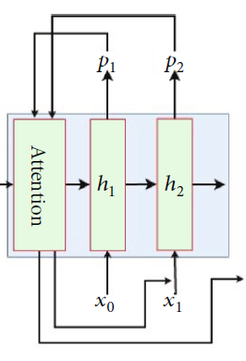
Architecture – Automatic Image Captioning Based on ResNet50 and LSTM withSoft Attention
Caption
1D Vector
RESNET50(Encoder)
LSTM(Decoder)
AICRL is based end-to-end on a neural network consisting of a RESNET50 CNN followed by a language generating RNN
Inspiration
The main drawbacks of the work are the quick model overfitting, so they use the heavy and expensive GoogLeNet with 22 hidden layers and the absence of attention layer that significantly improved the description accuracy
Summary
Extract visual features, which use ResNet50 network as the encoder to generate a one-dimensional vector representation of the input images
Soft Attention mechanism

Slide 7
Pre Processing
Feature Engineering
Pick Model & Hyper Parameters
Model Training and Optimization
Evaluate Model
Deploy on Server
Integrate and Test
Read the Annotations and Image data mapping from Flickr8k_Text to build Input – Image and Corresponding Caption(s)
Feature extraction using pretrained Resnet50 to a 1D Vector
Soft Attention to extract more relevant feature of the image
ResNet50 - 1D
TensorFlow/Pytorch based Model
LSTM
Cross Entropy Loss Function , Adam/SGD Optimizer
Hyper parameters – determined Iteratively
Hyper parameters Learning Rate , Epochs, Batch Size, Drop out derived iteratively
X train = Image
Y Train = Caption derived from Pre processing
1000 images (dev) and captions
Captions and ratings provided in Flickr8k_Text
Rating Standard BLEU
Compare the outcome from LSTM Vs Rated Image caption data
FastAPI/Heroku
Cloud Computing
Hosting Services
API
Test model using 1000 test images
Check the rating of the Test images
User Input
Test the caption generated for image as User input provided on a Web page
Key Steps
Inputs
Files
Flickr8k.token
Flickr_8k.trainImages
ResNet50 Model
LSTM
Optimizer
LSTM Implementation
BLEU
Flickr8k_Text
BLEU
BLEU
Flickr8k_Text
BLEU

Slide 8
Thank You!!

